Slide 1
Angular
Frontend Overview | JS vs TS | React vs Angular | Installation and Setup | Create a new Project and Run| Why so many Files?| Basics (Components, String interpolation, Inputs, Outputs, Event and Property Binding, Control Flow Statements, Life Cycle Hooks) | Self Study Topics

Slide 2
Frontend Overview
Frontend Comprises of 3 main things:
HTML
CSS
JS
HTML (Hyper Text Markup language): Gives basic structure of a web page
CSS (Cascading Style Sheets): Adds styles and appeal to a web page
JS (JavaScript): Adds Functionality of a web page

Slide 3
JS (JavaScript) vs TS (TypeScript)
JavaScript:
A dynamically typed, interpreted language that runs in browsers and on Node.js.
Types exist at runtime only; mistakes like wrong argument shapes or misspelled props surface when the code runs.
TypeScript:
A superset of JavaScript that adds a static type system and a compiler.
You write .ts (or .tsx), the TypeScript compiler transpiles to plain JS that runs anywhere JS runs.
TypeScript is just JavaScript + types + tooling. It helps Devs write clearer, safer code and makes large projects much easier to maintain.
It doesn’t enforce types at runtime (types are erased).

Slide 4
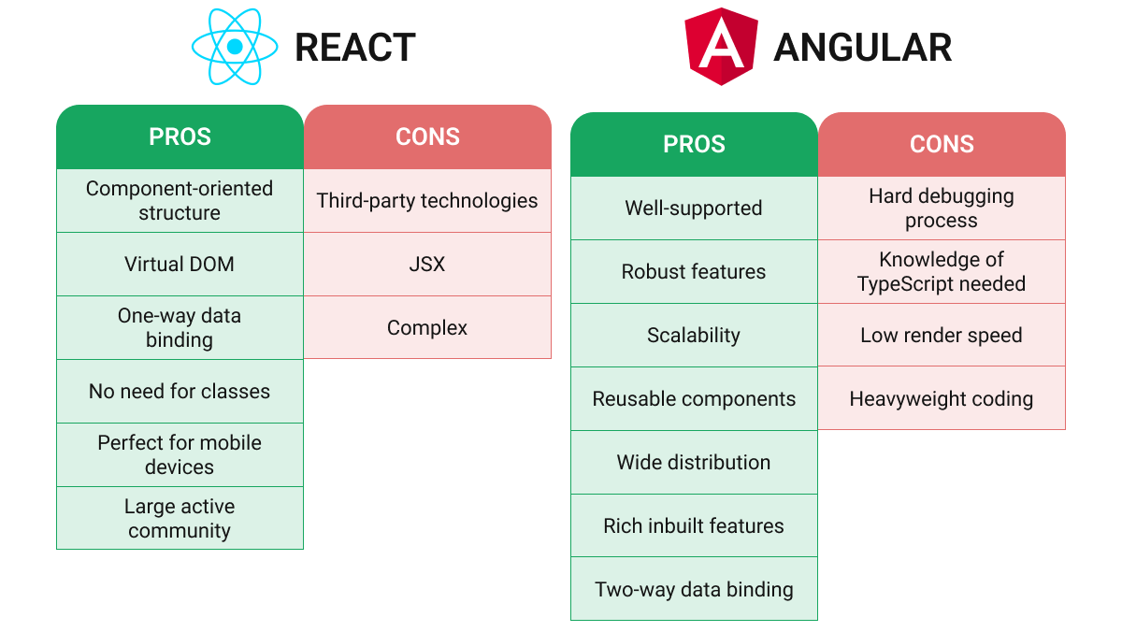
React vs Angular

Slide 5
Installation and Setup
Pre-Requisites
Node
VS Code
Command to Check if node is installed:
node -v
Command to install Angular (Below Command installs latest version 20)
npm install -g @angular/cli
Command to Check if angular is installed:
ng v
A bit about versions
We’ll be studying version 17

Slide 6
Create a new Project and Run
Command to create a new Project:
ng new <project-name>
Command to Run and see what’s inside the new Project
ng serve

Slide 7


Slide 8
Basics
Components:
The basic building block in angular.
Can be created by the either of the following command:
ng generate component <component- name>
ng g c <component- name>
Each component comprises of 4 files
sample-component.html (HTML file)
sample-component.ts (TS file)
sample-component.scss (Styleing file)
sample-component.spec.ts (Testing file)
String Interpolation:
Method to refer code (TS) variables in template (HTML)
Syntax: {{myVariable}}

Slide 9
Basics
Inputs:
Angular Components have a method of taking in inputs to make then reusable
Any input from parent can be used inside the component in any logic
Outputs:
Angular components can emit inputs to their parent after doing some task or after user interactions
Property Binding:
Just as in HTML we can bind code variables to template using angular's property binding
Events handling:
Output events can bind to functions that can do required tasks

Slide 10
Control Flow Statements
Angular templates support control flow blocks that let you conditionally show, hide, and repeat elements.
@if , @else-if , @else
@for and @empty
@switch, @case, @default

Slide 11
Lifecycle Hooks
Angular Components have their life cycle, which starts from components creation to their destruction.
Angular allows us to tap in some phases of life cycle by using these hooks.
Currently, component life cycle has 4 phases and these phases have multiple hooks
These phases are:
Creation
Change Detection
Rendering
Destruction

Slide 12
Self Study Topics
What is a decorator? Where can you find decorator in a Component?
What is View Encapsulation, Its Types and Impact
How Angular know it has to start with AppComponent?

